Slide 1
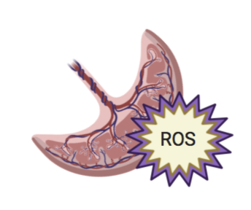
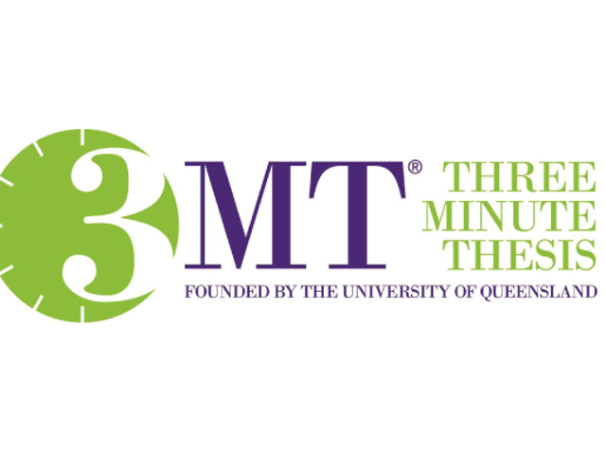
Preventing Chronic Disease Before Birth: Can exercise protect against placental oxidative stress?
Ericka Biagioni
PI: Nicholas Broskey, PhD

Slide 2
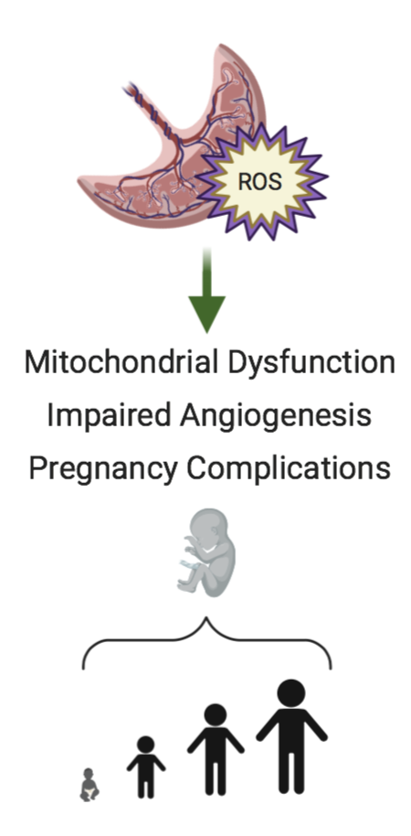
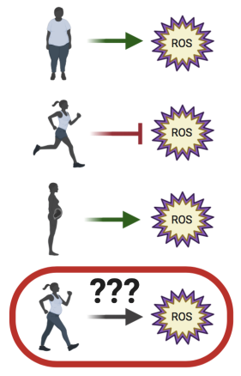
Preventing Chronic Disease Before Birth: Can exercise protect against placental oxidative stress?
What We Know
Theory
Method

