Slide 1
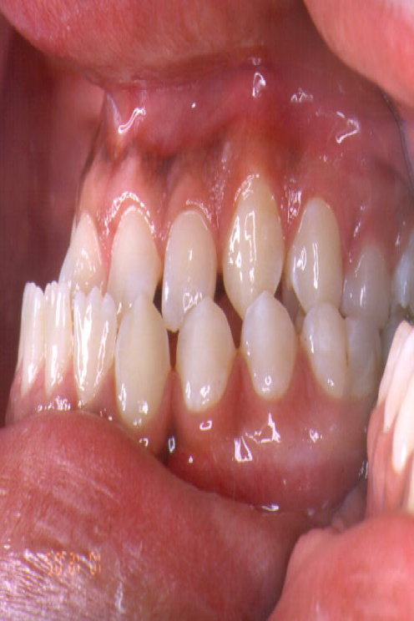
A leaky hose in your throat: Hypernasality following maxillary advancement

