Slide 1
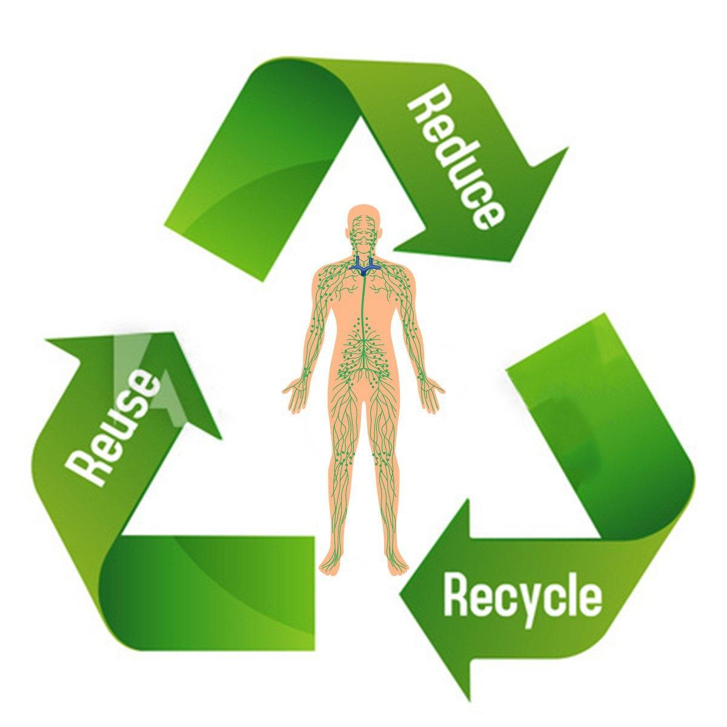
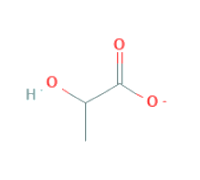
3 Rs in Human Body Systems
( Lactate as an example)
Lactate
Lactate
Angiogenesis
HUVECs Behavior
Lactate
Lactate
Gluconeogenesis
Alanine Production
Lactate
Lactate
Energy Production
TCA Cycle
Lactate
Metastasis

Slide 2
Fatema Salem
East Carolina University – Brody School of Medicine
Interdisciplinary Biological Sciences – Chemistry Department
3 Rs in the Human Body Systems ( Lactate as an example)

