Slide 1
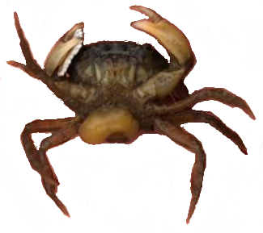
Interactions among Hosts, Parasites, and Mercury,
with Changing Salinity
Blakeslee and Tsui labs (unpublished)

