Slide 1
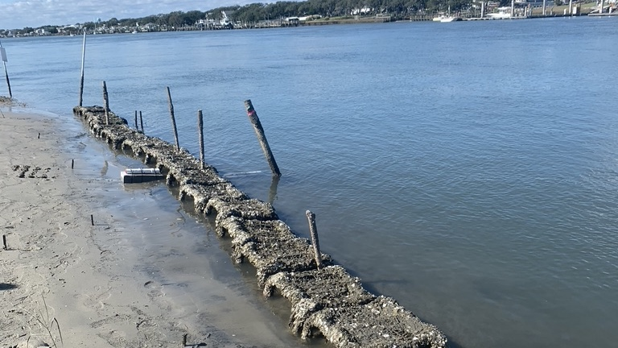
Borrowing ecological principles: Effect of substrate orientation and complexity on reef formation
Nina C. Woodard
Rachel K. Gittman

Slide 2
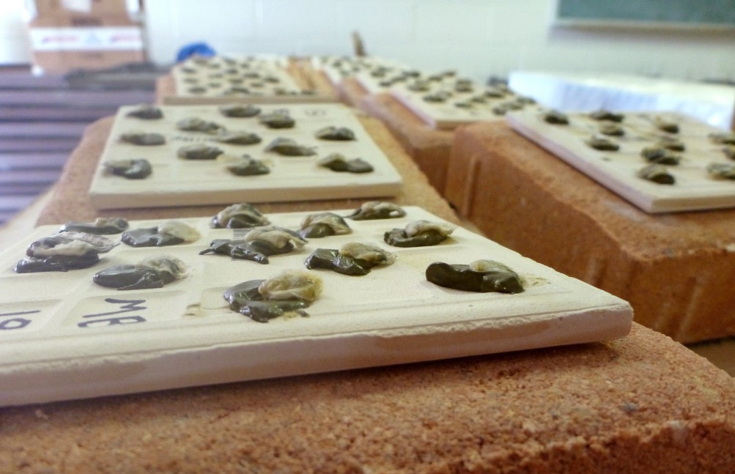
Above: Simple Oyster Settlement Tile
Below: Complex Oyster Settlement Tile
Fusion3 F400-S 3D Printer – East Carolina University Joyner Library 3D Print Studio

