Slide 1
Your Age is Showing
Presentation by: Samantha Dowiarz
Mentor: Dr. Roger Rulifson

Slide 2
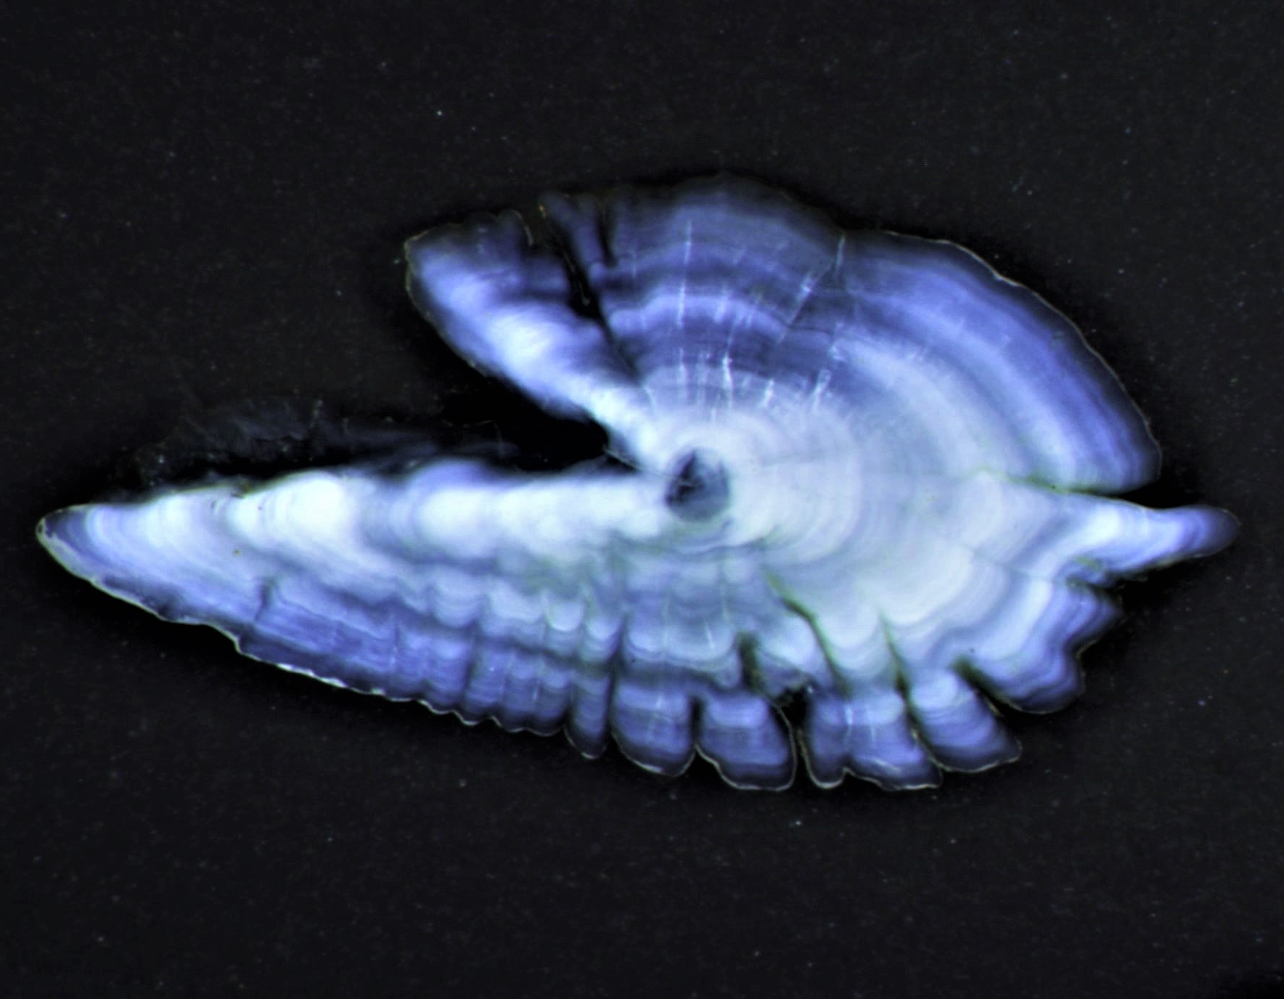
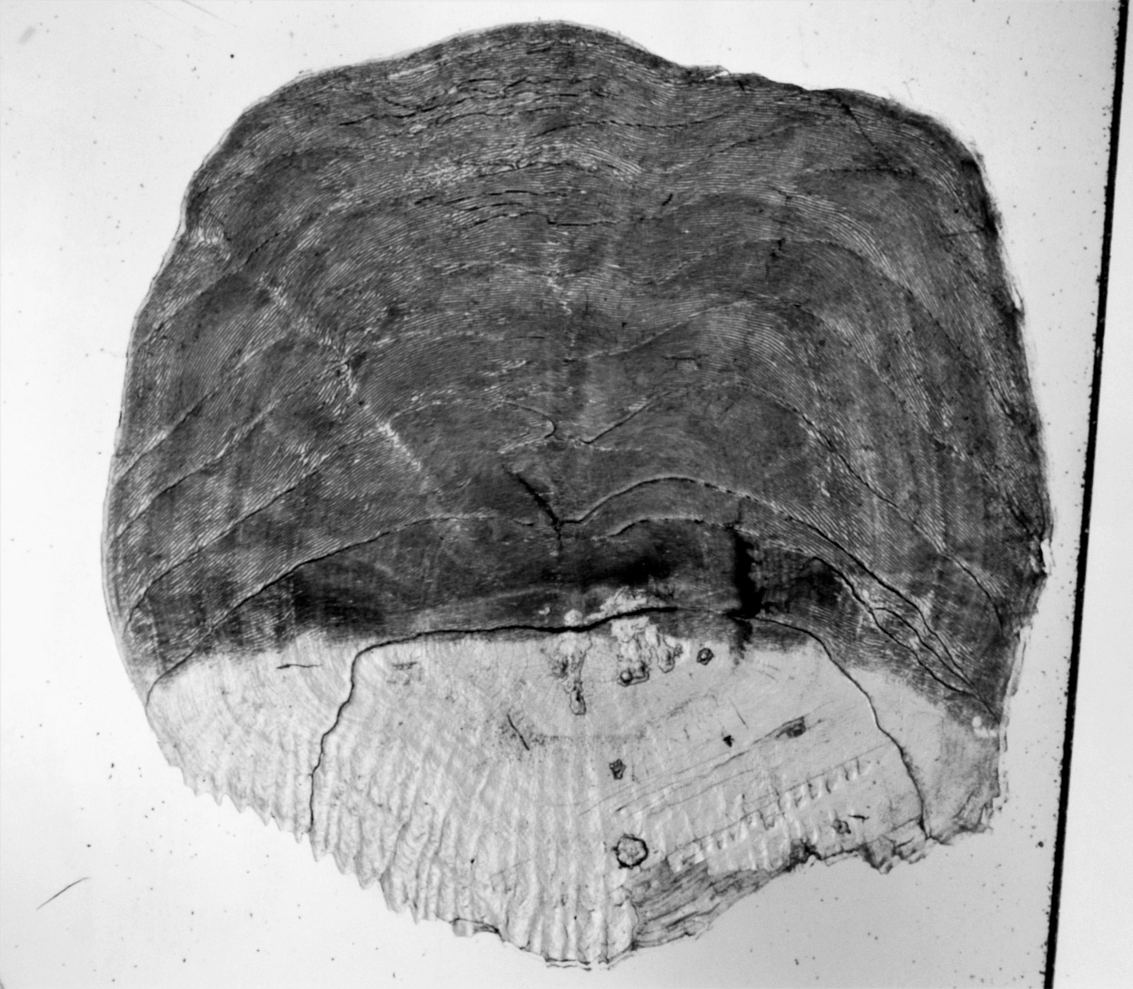
Your Age is Showing
Presentation by: Samantha Dowiarz

