Slide 1
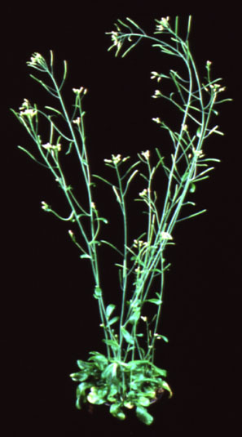
Characterization of Stress Impacts to Lipids involved in Photosynthesis
Fig.1
UV light, high light, cold, drought, chemicals, etc.
chloroplast membranes
damaged chloroplast membranes
Protection
Loss of protection
Photosynthetic ETC
Photosynthetic ETC
ROS
ROS
Fig.2
H₂O₂
H₂O
H₂O₂
H₂O₂
redox feedback
redox feedback
e-
Normal growth and development
Altered growth and development
(Altered gene expression, cellular damage, metabolic damage, etc.)
Reduction/oxidation
Arabidopsis thaliana
Fig.3
Redox associated mutants
Lipid associated mutants
Mutant Analysis (e.g. phenotypes, GC, photosynthesis)
Engineer plants with enhanced resilience
Novel double mutants
1 yr.
Implications: crop resistance, world hunger, human health, knowledge gaps
This Photo by Unknown Author is licensed under CC BY

